Slide 1


Major Project
On
E-AGRI KIT AGRICULTURAL AID USING DEEP LEARNING
Under the Guidance
of
G.KALPANA DEVI
(Assistant Professor)
By
POKKILI SAMPATHKUMAR (197R1A05P1)
MUTHE AKHILKUMAR(197R1A05N4)
RUDHRAMSH REDDY (197R1A05P3)

Slide 2
ABSTRACT
This project presents an agricultural aid application, developed and designed, to help farmers by utilizing Image Processing, Machine Learning and Deep Learning concepts.
Our application provides features such as early detection of plant disease, implemented using various approaches.
After evaluation, results showed that Convolutional Neural Network was performing better for plant disease detection with an high accuracy.

Slide 3
ABSTRACT
It further helps the farmer to forecast the weather to decide the right time for agricultural activities like harvesting and plucking.
To avoid reoccurrence of disease due to loss in soil minerals, a crop specific fertilizer calculator is incorporated which can calculate the amount of urea, diammonium phosphate and muriate of potash required for a given area.

Slide 4
EXISTING SYSTEM
Image Processing is a popular first step in the process of plant disease detection and often includes multi-step processes to achieve processed, ROI centric input images for further classification.
In this approach, various Image Processing techniques were used on the input image to get a final output image which would mark the infected area and also calculate the percentage of area infected in the leaf.
The major advantage observed in this approach was that this approach eliminated the need to extract the leaf and place it on a black background during image capture for the algorithm to work.
In real time scenario, the infected leaf would be present amongst a cluster of mixed crops and this approach was able to segregate the infected leaf from the healthy ones in an input image.

Slide 5
DISADVANTAGES
Accuracy is Low.
This multistep algorithm is that it is not optimized and no better background elimination results.

Slide 6
PROPOSED SYSTEM
In the Deep Learning Approach, we decided to take a subset of the Plant Village dataset along with the cotton dataset to train and test the CNN model.
The input image is fed into this model, which initially took a portion of the Plant Village and Cotton Dataset, with a training -validation split of 70-30, therefore getting 4200 images for training and 1800 images for validation.
A CNN (Convolutional Neural Network) is a deep learning model that takes inputs which are assigned weights depending on various features.
Our CNN model consists of 4 main convolutional layers with 32, 64, 128, 128 filters consecutively, each followed by a ReLU activation function, max pooling and dropout layer.

Slide 7
ADVANTAGES
The reason for choosing CNN algorithm is that it is more optimized and thus gives better background elimination results than the previous multistep approach.
Accuracy is Very high.

Slide 8
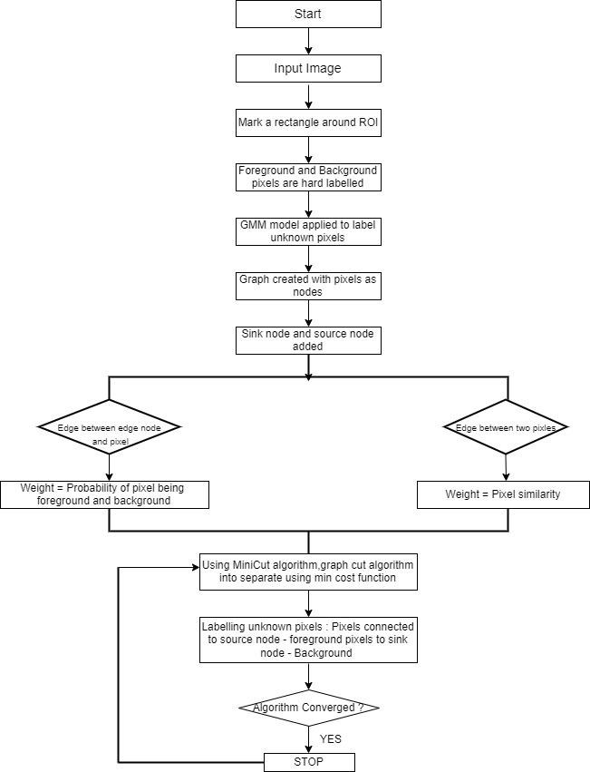
ARCHITECTURE

Slide 9
USE CASE DIAGRAM

Slide 10
CLASS DIAGRAM

Slide 11
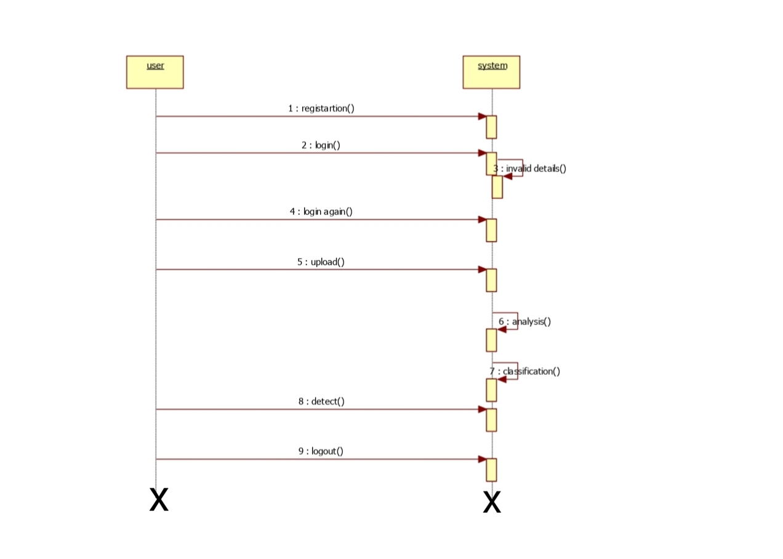
SEQUENCE DIAGARM

Slide 12
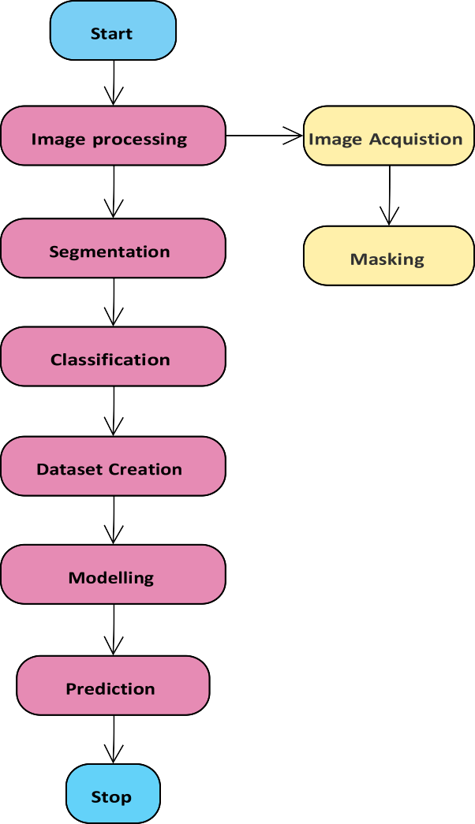
ACTIVITY DIAGRAM

Slide 13
REQUIREMENTS
HARDWARE REQUIREMENTS:
Processor – i3
Speed – 2.4 GHz
RAM – 4 GB
Hard Disk - 500 GB

Slide 14
REQUIREMENTS
SOFTWARE REQUIREMENTS:
Operating System: Windows
Coding Language: Python

Slide 15
IMPLEMENTATION
from future import division, print_function # coding=utf-8
import sys import os import glob import re
import numpy as np import pandas as pd import requests import pickle
# Keras
from keras.applications.imagenet_utils import preprocess_input, decode_predictions from keras.models import load_model
from keras.preprocessing import image
# Flask utils
from flask import Flask, redirect, url_for, request, render_template from werkzeug.utils import secure_filename
import sqlite3

Slide 16
# Define a flask app app = Flask( name )
UPLOAD_FOLDER = 'static/uploads/' # allow files of a specific type
ALLOWED_EXTENSIONS = set(['png', 'jpg', 'jpeg'])
# function to check the file extension def allowed_file(filename):
return '.' in filename and \
filename.rsplit('.', 1)[1].lower() in ALLOWED_EXTENSIONS

Slide 17
@app.route('/') def home():
return render_template('home.html')
@app.route('/logon') def logon():
return render_template('signup.html')
@app.route('/login') def login():
return render_template('signin.html')
@app.route("/signup") def signup():
username = request.args.get('user','') name = request.args.get('name','') email = request.args.get('email','') number = request.args.get('mobile','')

Slide 18
password = request.args.get('password','') con = sqlite3.connect('signup.db')
cur = con.cursor()
cur.execute("insert into `info` (`user`,`email`, `password`,`mobile`,`name`) VALUES (?, ?, ?, ?, ?)",(username,email,password,number,name))
con.commit() con.close()
return render_template("signin.html")
@app.route("/signin") def signin():
mail1 = request.args.get('user','') password1 = request.args.get('password','')
con = sqlite3.connect('signup.db')

Slide 19
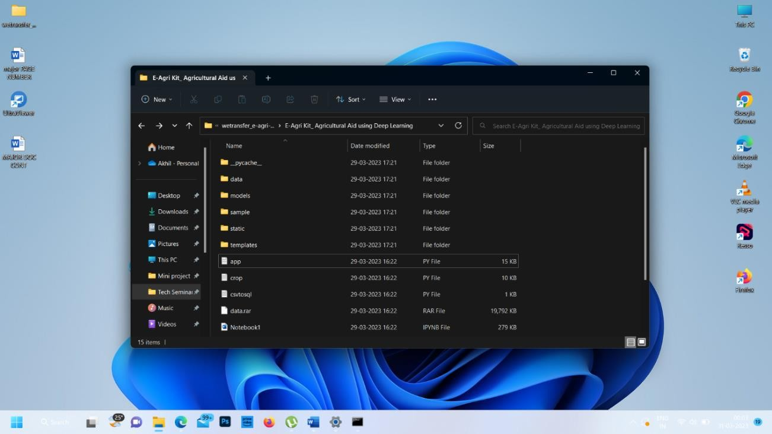
RESULTS
Opening the Application

Slide 20
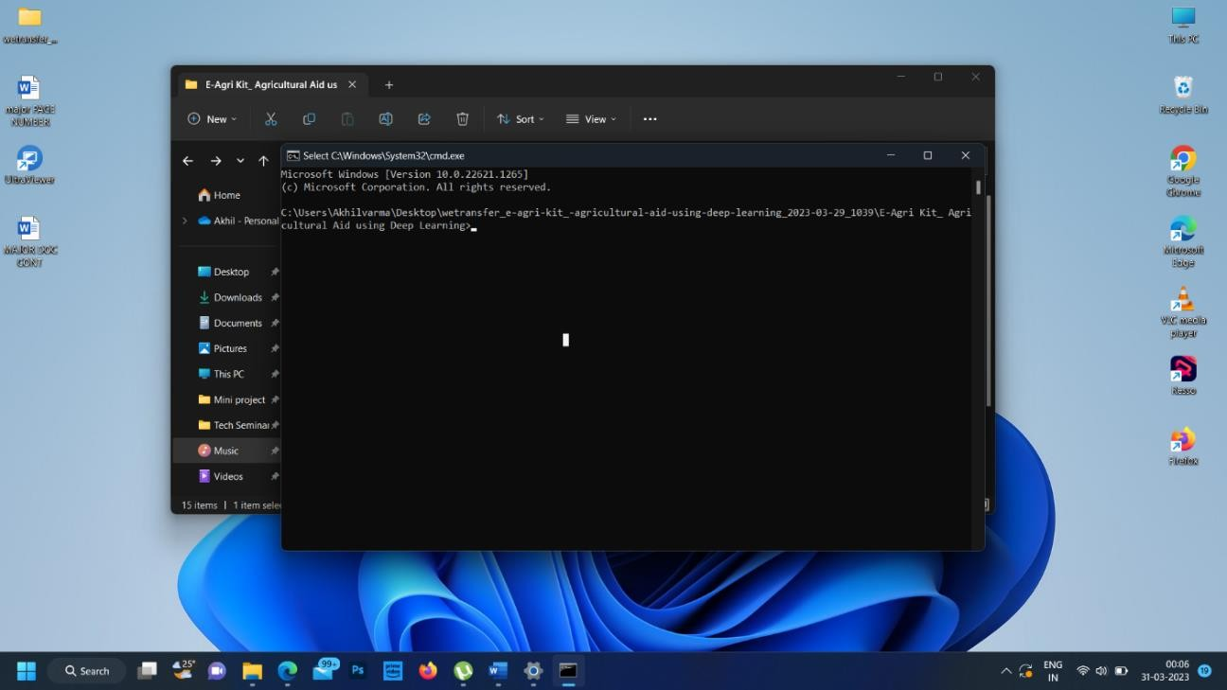
Running the Application

Slide 21
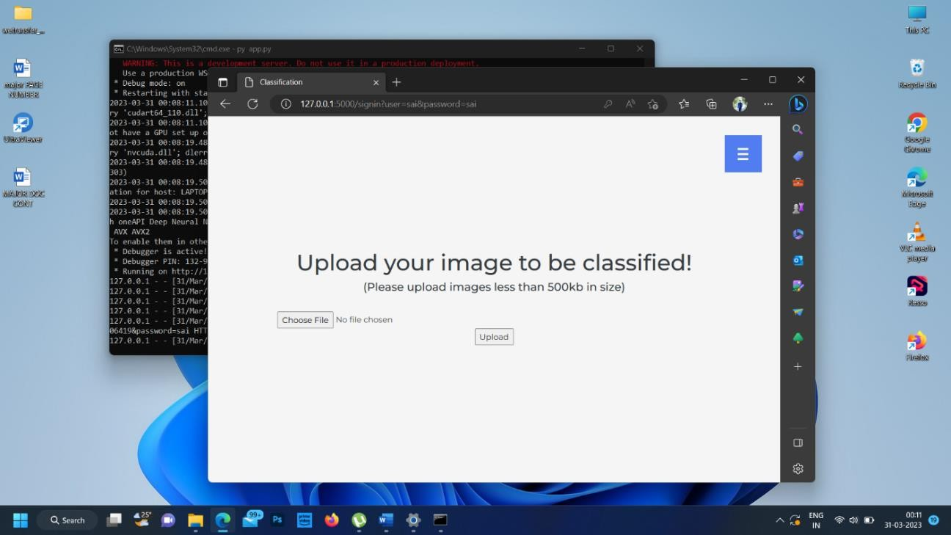
User Interface of the Application

Slide 22
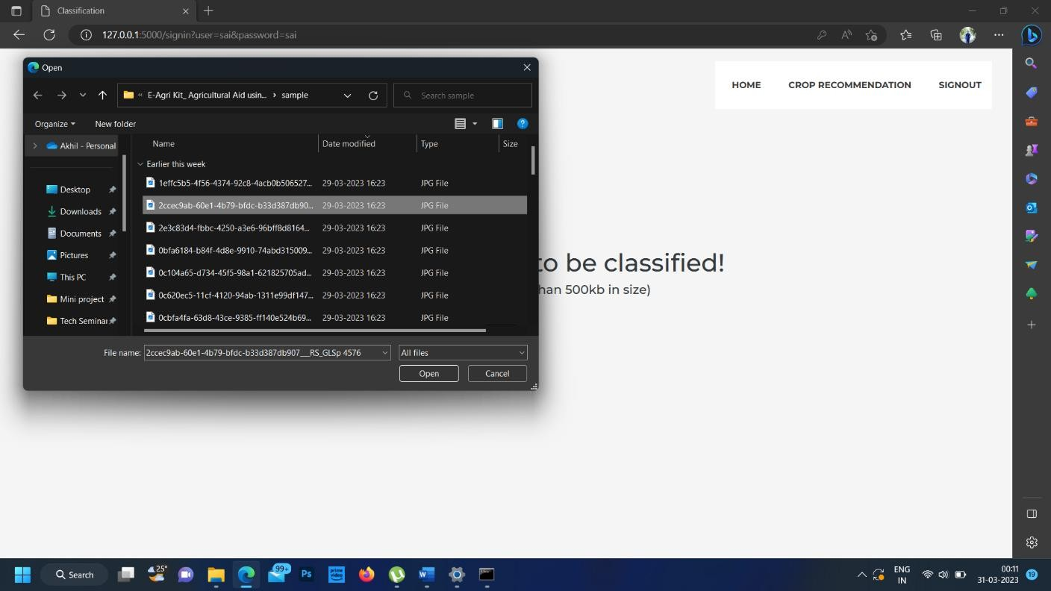
Uploading leaf Samples

Slide 23
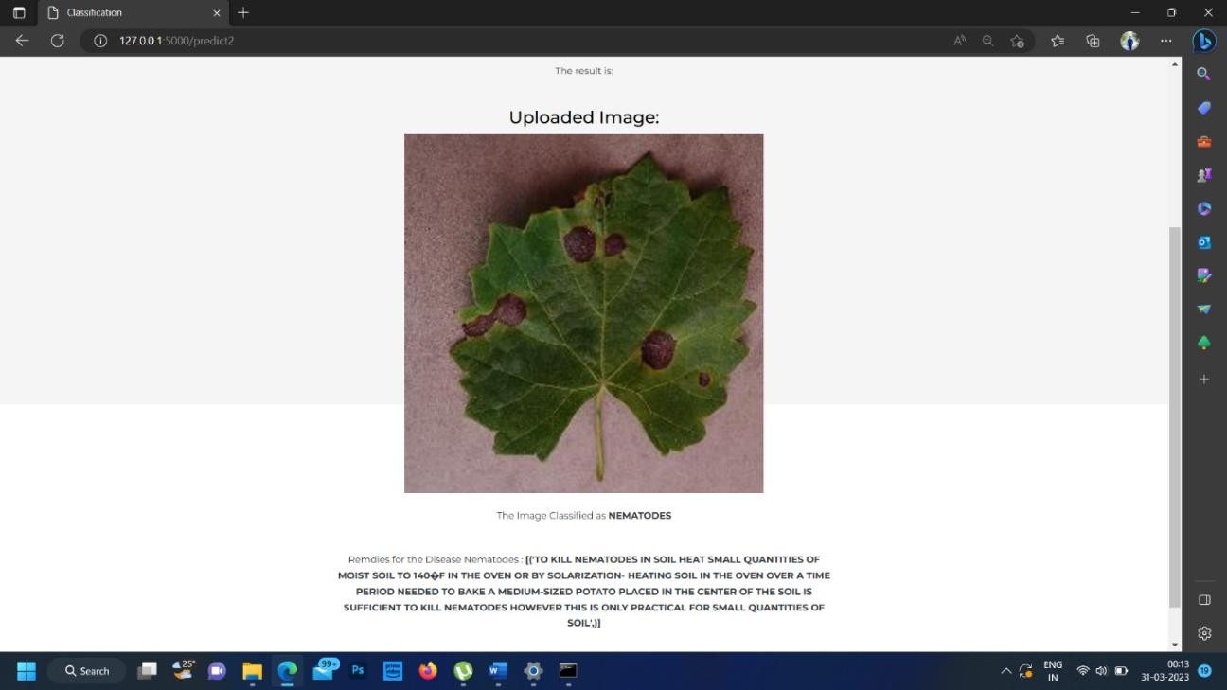
Detection of Disease

Slide 24
NOVELTY
Agriculture being a vital sector has a majority of the rural population in developing countries relying on it.
The sector is faced by major challenges like unprecedented pest attack and unforeseen weather conditions affecting their produce leading to major loss of food and effort.
Technology plays a vital role in uplifting the livelihoods of the rural populace which can be done by using a simple agro android application system.
Plant diseases can affect vast produce of crops posing a major menace to food security as well as leading to major losses to farmers.
Agricultural Aid which utilizes machine learning to provide plant disease detection.

Slide 25
CONCLUSION
During our analysis, we have understood the need for efficient plant disease identification & classification algorithms and prevention methods.
Due to a large number of crops and diseases available, it is crucial that the detection system should be able to adapt to the changing variables and trends.
Hence, Machine learning and Deep learning approaches were employed for this project which ensures that the code trains itself against as many possible numbers of different crops and diseases as possible The paper consists of an android application covering plant disease detection and other functionalities such as language translation, weather forecasting and fertilizer calculator.
With this application we aim to provide aid in the unprecedented agricultural activities and ensure a healthy plant.

Slide 26
BIBLIOGRAPHY
CropLife International (May 2015). India’s farmers fighting pests. Retrieved from: https://croplife.org/news/keeping-indias-pests-in-line/
Economic Times (Sept 2018). India sets record farm output target for 2018-19.
Sharada P. Mohanty David P. Hughes and Marcel Salathé.”Using Deep Learning for Image-Based Plant Disease Detection.”Front. Plant Sci., 22 September 2016
Carsten Rother, Vladimir Kolmogorov, and Andrew Blake. 2004. “GrabCut”: interactive foreground extraction using iterated graph cuts. In ACM SIGGRAPH 2004 Papers (SIGGRAPH ’04). Association for Computing Machinery, New York, NY, USA, 309–314.

Slide 27
Thank you

